Slide 1
NOTES MANAGEMENT

Slide 2
Introduction:-
Generally, the notes are circulated on WhatsApp or any kind so it gets exceptionally troublesome to manage the important notes at the time of require.
This framework will give a simple approach to share the documents for study
purpose.

Slide 3
Different users can work simultaneously on the framework.
It'll be simple for the instructors to circulate the notes to each and every student.
The framework will be utilized by students and instructors in colleges and indeed it can be utilized by schools.

Slide 4
There are numerous students who confront issue in studying at the exam time since either they don’t have the notes given by instructors or they must have not been within the college.
This Framework will give a stage to easily access the notes.

Slide 5
It'll decrease the manual paperwork, reduced the sharing and distribution time.

Slide 6
Objectives:-
The Objective of Notes management system is to provide better facility to the students and instructors to bring out the easy circulation of documents within healthy environment.
It'll decrease the manual paperwork, reduced the sharing and distribution time.

Slide 7
Existing System:-
Mostly the notes are circulated on WhatsApp or any kind so it gets
very difficult to manage the important notes at the time of need.
There are many students who face problem in studying at the exam time because either they don’t have the notes provided by teachers or they must have not been in the college.

Slide 8
This System will provide a platform to easily access the notes.
It has always been the tedious process to borrow the notes from the
senior.

Slide 9
It is very hard to find the right person who can employ with
their notes they have passed.
Note circulation system is eradication of this problem.
It gives the platform where the person is recommended
to the user as per their note’s requirement.

Slide 10
Proposed System:-
This system will provide an easy approach to share the documents for studying purpose.
Multiple users can work simultaneously on the system.
It will be easy for the teachers to circulate the notes to each and every student.
The system will be used by students and teachers in colleges and even it can be used by schools.
The Objective of Class Notes Gallery is to provide better facility to the students and teachers to bring out the easy circulation of documents within healthy environment.
It will reduce the manual paperwork,reduced the sharing and distribution time.

Slide 11
Requirement
1. Hardware Requirements:-
Processor :- core i3 or Above
RAM :- 512 mb or2 More
HardDisk :- 15 Gb or More.
Processing Speed :-2.6 GHz

Slide 12
2. Software Requirements:-
Operating system :- windows 7 or above
Front End :- HTML , JavaScript , CSS
Server :- Apache Tomcat 5 or above
IDE :- Adobe Dreamweaver
Database:- MySQL

Slide 13
Data Modules
Staff Module
Student Module

Slide 14
Staff Module
He is an super user, who can add the notes ,view the notes. He can see the feedback of the students for his notes.
If any problem in the notes, he can work on that and can get best response by the students.

Slide 15
Student Module
He can only view/see the notes which are uploaded by the staff,but he cannot add the notes.
He can give the feedback to the notes given by the staff,so they can improve in their work if they have issues.

Slide 16
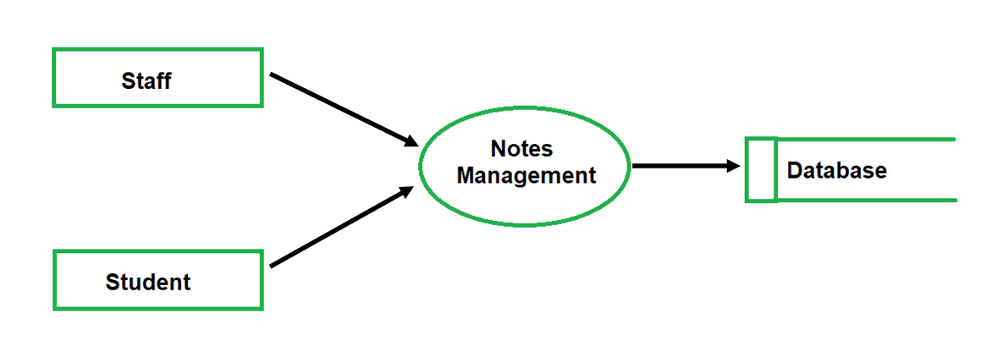
DFD(data flow diagram) of Modules:- Level 0 DFD

Slide 17
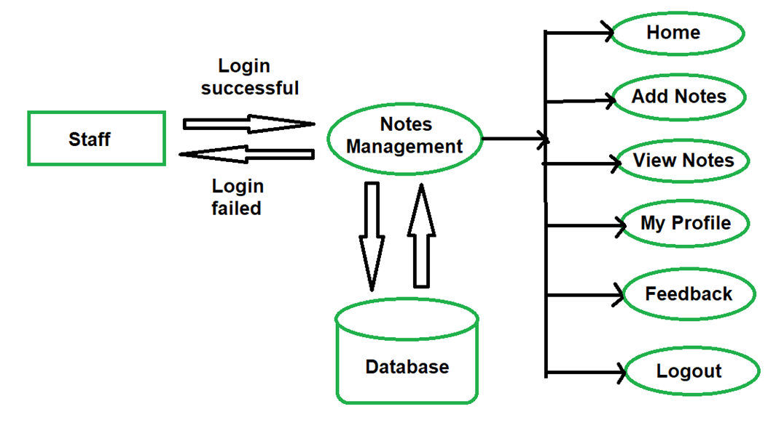
LEVEL 1 DFD Staff :-

Slide 18
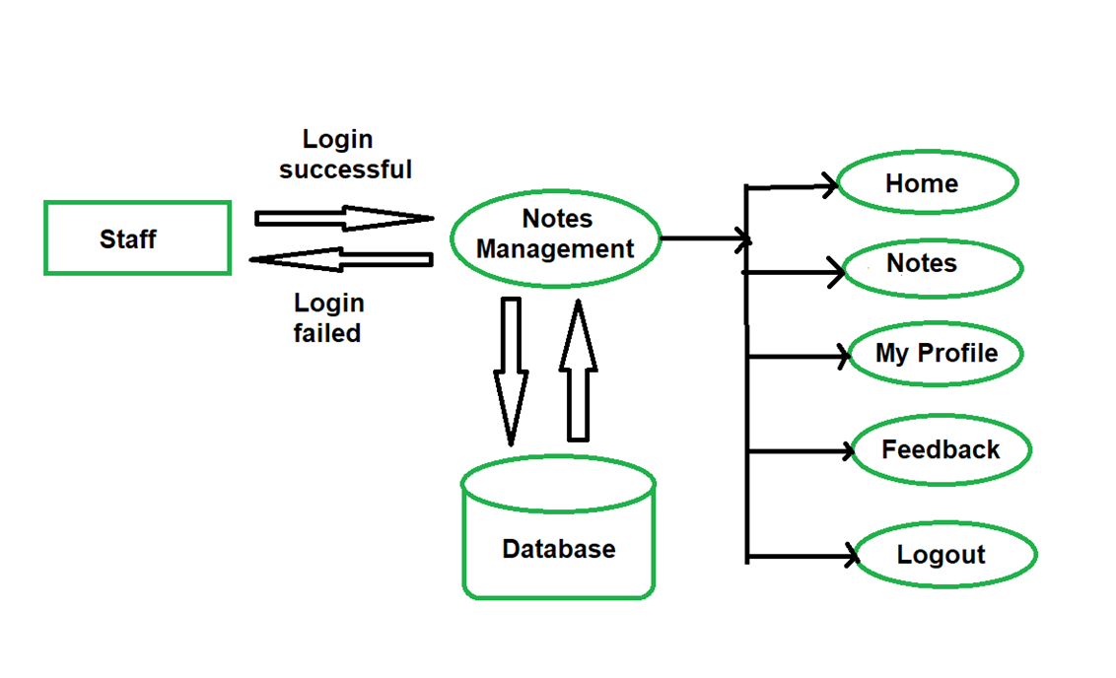
Student :-

Slide 19
SCREEN SHOTS

Slide 20
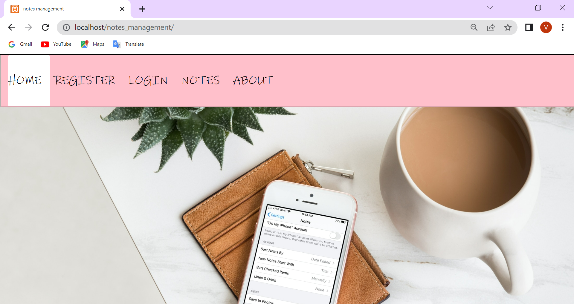
Home page

Slide 21
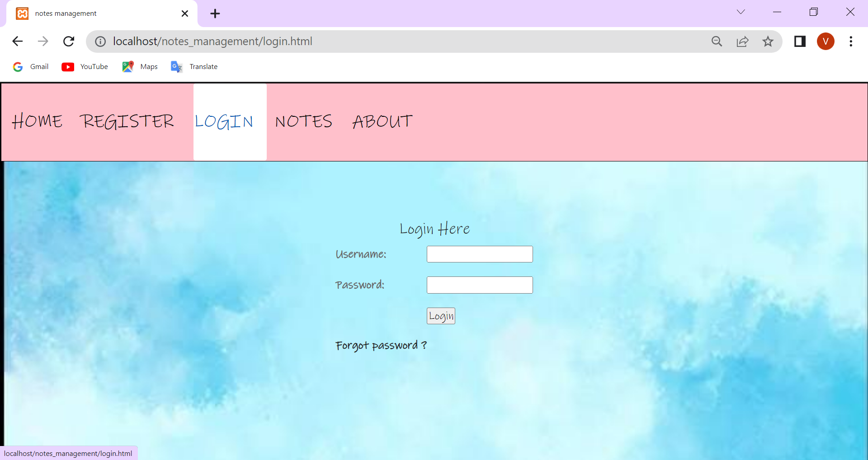
Login page

Slide 22
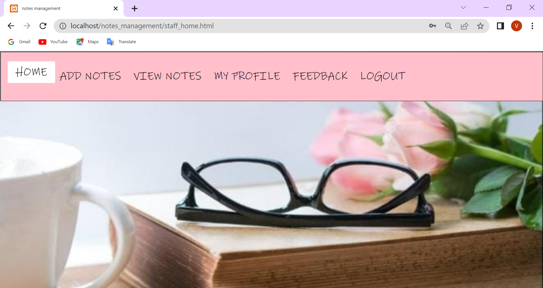
Staff Home page

Slide 23
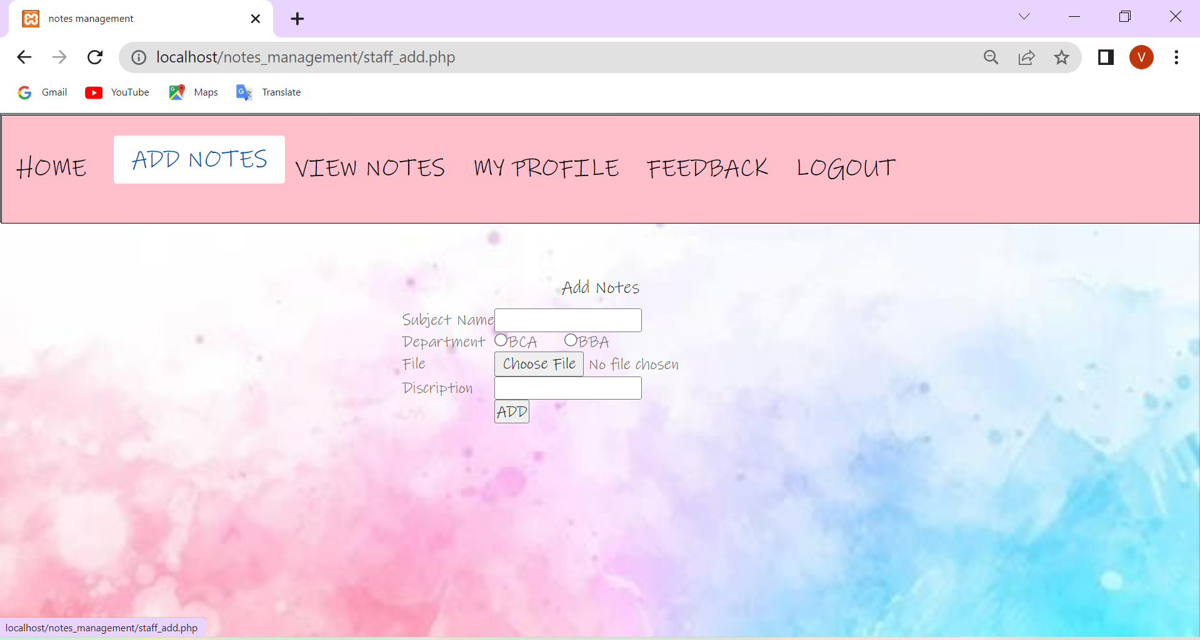
Add Notes

Slide 24
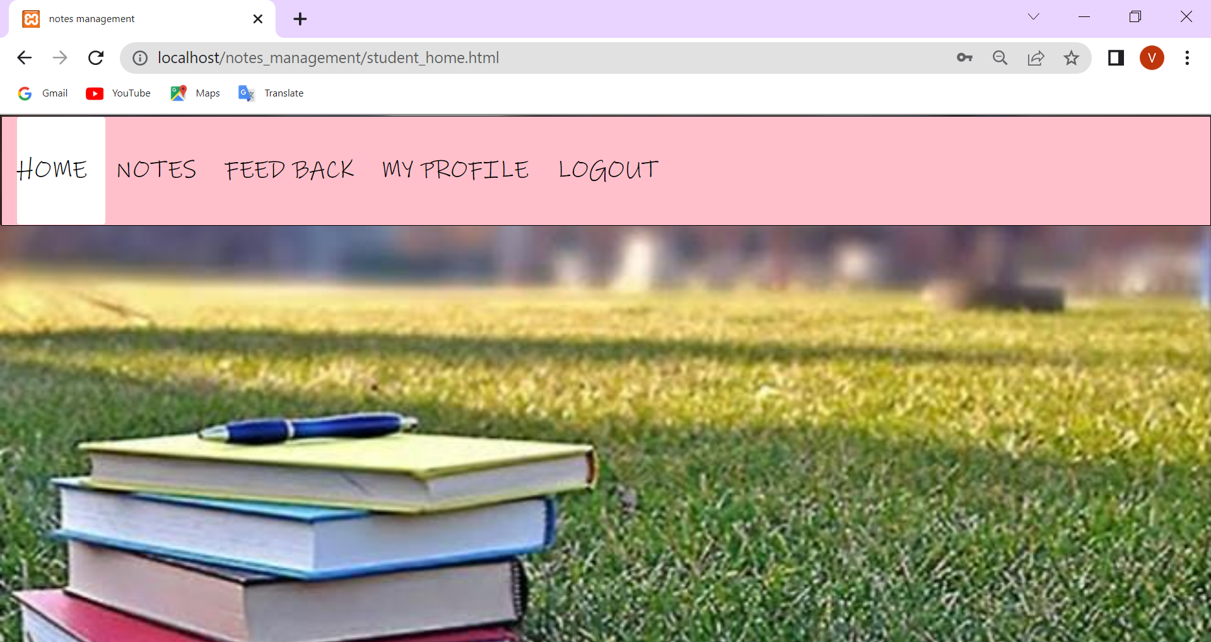
Student Home page

Slide 25
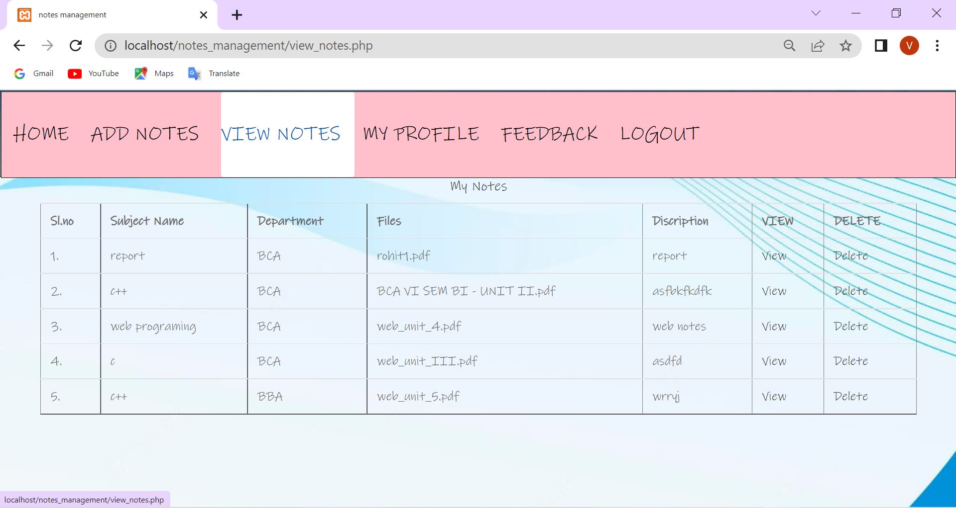
View Notes

Slide 26
Advantages
This system will provide an easy approach to share the documents for studying purpose.
It is to provide better facility to the students and teachers to bring out the easy circulation of documents within healthy environment.

Slide 27
It will be easy for the teachers to circulate the notes to each and every student.
Time will be saved by this method.
It will reduce the manual paperwork .

Slide 28
Reference
www.w3schools.com
www.tutorialpoints.com
www.greenforgeeks.org
www.stackoverflow.com

Slide 29
Future Enhancement:
The project has a exceptionally tremendous scope in future. The project can beimplemented on intranet in future.
Project can be upgraded in near future as and when necessity for the same arises, because it is exceptionally adaptable in terms of development.
With the proposed software of notes management system will be ready to use by any association hence run the complete work in a much superior, precise and mistake freeway.

Slide 30
The following are long term scope for the project.
1- Only a specific association individual can use this system.
2- Special ID of students and instructors will be generated by the system.
3- Mailing framework will be done with the message alert system.

Slide 31
Conclusion:
It has been a matter of immense delight, respect and challenge to have this opportunity to take up this venture and complete it effectively.
It was a pleasant experience working with the professors.
This will be helpful when we are going work in industry & educational field where we can put all these it in our practice.
While creating this framework Notes management system, I have learnt a part about the working of system.
Amid the development process, I have got it the concept of planning and building a system.
Whereas working on my framework I have utilized all the information which was instructed us and all that produces
this project complete.

Slide 32
Thank you

